Slide 1

K- NEAREST NEIGHBOUR REGRESSION
Presented By:
Name : P. Aakaanksha
Emp ID : 4680
Batch : 115

Slide 2

Contents
Introduction to KNN
KNN working Algorithm
How to choose value of k
Distance metrics
Hyper-parameters and Hyper-parameter tuning
Loss function
Pseudo code of KNN
Model Evaluation of KNN
Improving techniques
Real time applications
Pros and Cons Of KNN
Comparison

Slide 3
Introduction to KNN Regression
KNN (K-Nearest Neighbors) regression is a machine learning algorithm used for regression tasks.
It is a non-parametric method, meaning it does not make any assumptions about the distribution of the data. Instead, it relies on the similarity between the input data points to make predictions.
In KNN regression, the predicted value of a new data point is based on the K nearest data points in the training set.
The value of K is a hyperparameter that needs to be specified before training the model.
The distance metric used to measure the similarity between data points can vary, but typically the Euclidean distance is used.
To make a prediction for a new data point, KNN regression finds the K nearest neighbors in the training set and calculates their average output. This average output is used as the prediction for the new data point.
KNN regression can be used in various regression tasks, such as predicting house prices, stock prices, or customer churn. It is a simple yet effective algorithm that can provide accurate predictions when used appropriately. However, it may not be suitable for datasets with high dimensionality or noisy data.

Slide 4
KNN Working Algorithm
The algorithm works as follows:
Training : Select the dataset and train the algorithm using a labeled dataset.
Determine the value of K: which is a hyperparameter of the algorithm.
Calculating the distance metric : The algorithm calculates the distance between the new data point and all the data points in the training set.
Selecting the nearest neighbor: Based on distance metric, the k nearest data points are selected to the new point in the training dataset.
Calculating the predicted output: Take the average output of the K nearest neighbors. This average output is used as the predicted output value for the new data point.
Evaluating the model: Evaluate the model by using various of metrics such as MSE or R-squared.

Slide 5
Choosing the value of K
Choosing the right value of k is an important step in KNN (K-Nearest Neighbors) regression, as it can greatly impact the accuracy of the algorithm.
Here are some techniques for selecting the optimal value of k:
Trial and error: It is the most common technique used to choose the value of k to see which one gives the best results on validation set. It is a time consuming approach but can be effective if there is no more prior to knowledge of data.
Cross-validation: Cross-validation is another technique that can be used to select the optimal value of K. This involves dividing the training set into multiple k equal subsets (or "folds") and the model is trained for k times, each time using different subset as validation set. The performance of the algorithm is then averaged across the k runs and the value of k that gives the best performance is chosen.
Domain knowledge: Domain knowledge can be useful in selecting the value of k. For example, if the data has a known underlying smooth function, a larger value of k may be more appropriate. Similarly, if the data is known to have abrupt changes, a smaller value of k may be better.

Slide 6
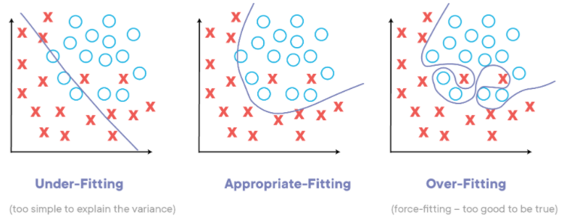
Distance metric: The choice of distance metric can also impact the choice of k. For example, if the data has many dimensions and the distance metric is Euclidean, it can be more difficult to distinguish between data points, and a smaller value of k may be better.
Grid search: Grid search is a technique for systematically searching over a range of values for a hyperparameter, in this case k. This technique involves specifying a range of k values to search over, and training and evaluating the algorithm for each k value. The k value that gives the best performance is then chosen.

Slide 7
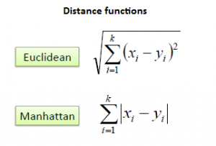
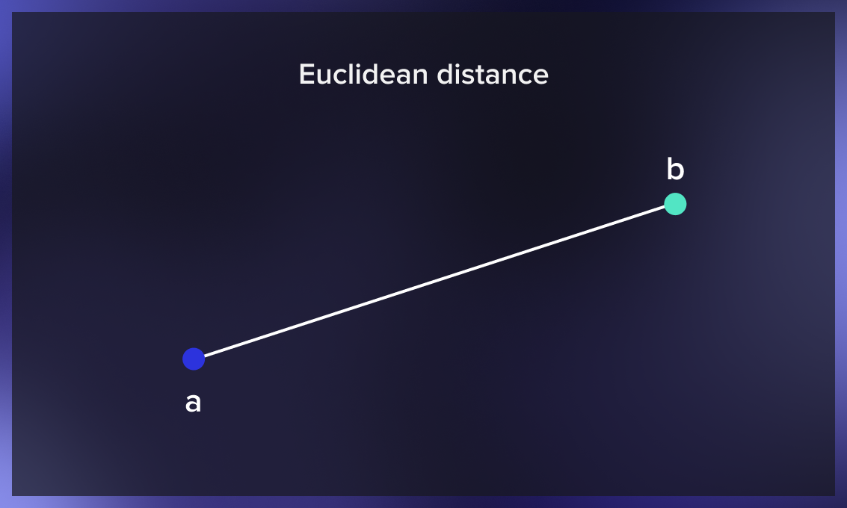
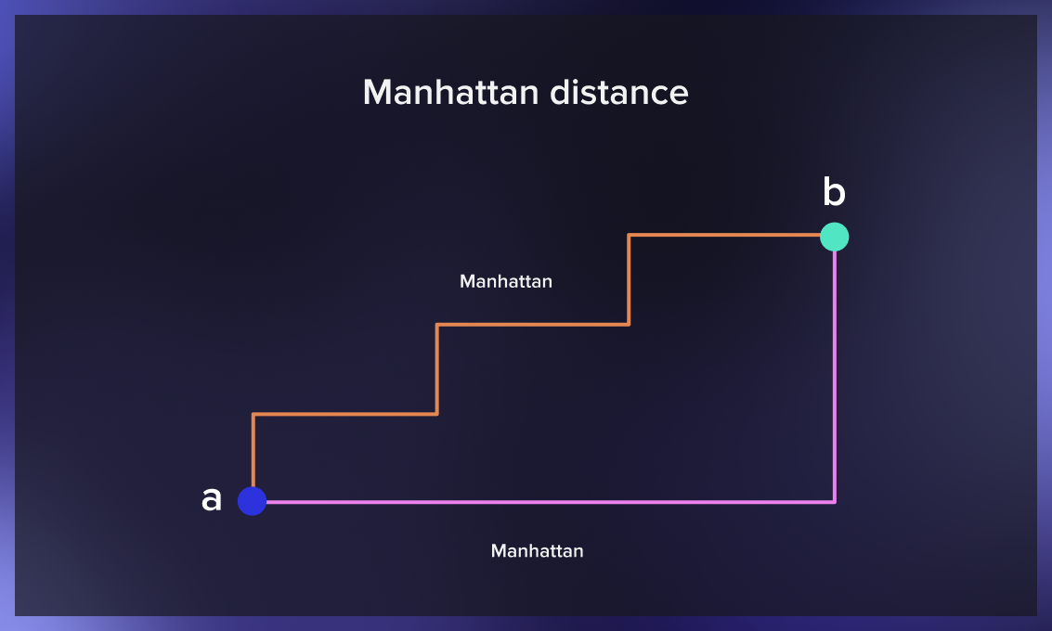
Distance metrics
Euclidean Distance: It is the most commonly used distance metrics for KNN. Euclidean distance is calculated as the square root of the sum of the squared differences between a new point (x) and an existing point (y).
Manhattan Distance: This is the distance between real vectors using the sum of their absolute difference.

Slide 8
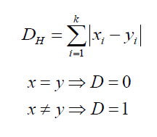
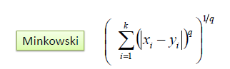
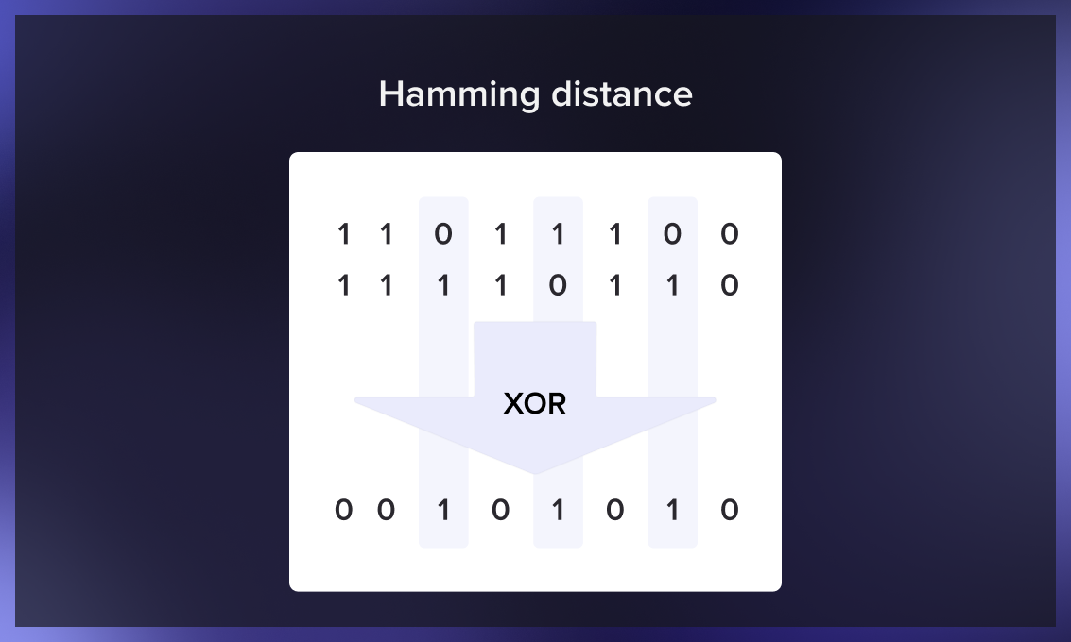
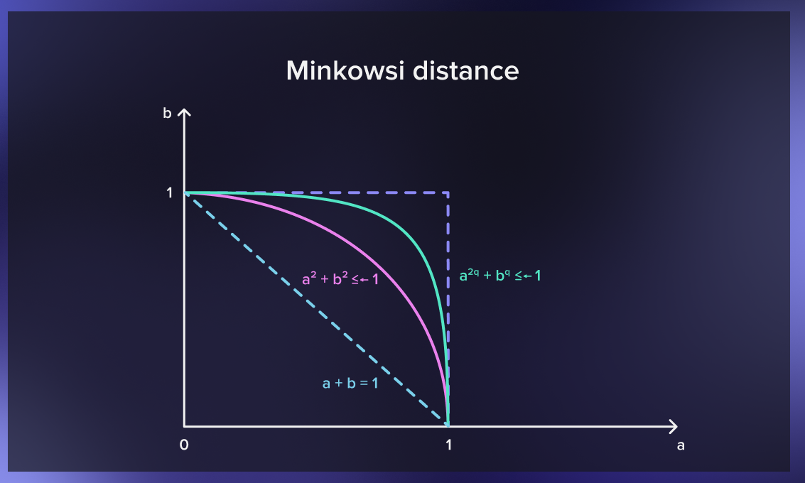
Hamming Distance: It is used for categorical variables. If the value (x) and the value (y) are the same, the distance D will be equal to 0 . Otherwise D=1.
Minkowski Distance: generalizes the Euclidean and Manhattan distances. It adds a parameter called “order” that allows different distance measures to be calculated. Minkowski distance indicates a distance between two points in a normed vector space

Slide 9
Hyper-parameters of KNN
k: The number of nearest neighbors to consider when making a prediction. This is the most important hyperparameter in KNN regression, and the optimal value of k depends on the dataset and the problem at hand. A larger value of k makes the model more robust to noise and outliers, but may also result in underfitting.
Distance metric: The distance metric used to calculate the distance between data points is another important hyperparameter. The most commonly used distance metrics in KNN regression are Euclidean distance, Manhattan distance, and Minkowski distance. The choice of distance metric can have a significant impact on the performance of the model, and the optimal metric depends on the characteristics of the data.
Weighting scheme: The weighting scheme to use when averaging the output values of the k nearest neighbors. One common weighting scheme is to use inverse distance weighting, where the closer neighbors have more influence on the prediction.
Preprocessing of the input features: Preprocessing of the input features can also affect the performance of the model. Some common preprocessing techniques include normalization, standardization, and feature scaling.

Slide 10
Number of features: KNN regression can also be sensitive to the number of features in the dataset. High-dimensional datasets may require dimensionality reduction techniques such as Principal Component Analysis (PCA) or feature selection to improve the performance of the model.
Tuning of Hyperparameters in KNN
Define the hyperparameters: The hyperparameters in KNN regression include the number of neighbors (K), the distance metric, and the weighting function.
Choose a range of values for each hyperparameter: For example, you could choose a range of values for K, such as 1 to 10, and a range of distance metrics, such as Euclidean distance, Manhattan distance, and Chebyshev distance.
Define a performance metric: This could be the mean squared error (MSE) or R-squared.
Train and evaluate the model: Train and evaluate the KNN regression model using each combination of hyperparameters and performance metric. This is typically done using a validation set or cross-validation.

Slide 11
Select the best hyperparameters: Select the hyperparameters that result in the best performance on the validation set or in cross-validation.
Retrain the model: Once the best hyperparameters have been selected, retrain the KNN regression model using the entire dataset with these hyperparameters.
Evaluate the final model: Evaluate the final KNN regression model using the test set to ensure that the performance is consistent with the validation set.
Key point:
hyperparameter tuning can be time-consuming, especially if a large number of hyperparameters and a wide range of values are considered. It is therefore important to use an efficient search strategy, such as grid search, randomized search, or Bayesian optimization, to find the best hyperparameters in a reasonable amount of time.

Slide 12
Loss function
K-Nearest Neighbors (KNN) regression is a distance-based algorithm and does not use a loss function to optimize its parameters.
Instead, KNN regression simply stores the training data in memory and uses it to make predictions on new data points based on the distance between the new data point and the training data.
Therefore, unlike other regression algorithms that minimize a loss function to optimize their parameters, KNN regression does not have any parameters to optimize.
This makes it a simple and easy-to-use algorithm that can be applied to a wide range of regression tasks without the need for extensive hyperparameter tuning or training.

Slide 13
Pseudo code for KNN
For each data point x in the test data, the algorithm calculates the distance between x and every data point in the training data.
The k nearest neighbors to x are selected based on the smallest distances.
The predicted label for x is then calculated as a weighted average of the labels of the k nearest neighbors, where the weights are the distances between x and the k neighbors.
The predicted label is then appended to an array of predicted labels for the test data.
Finally, the predicted label array is returned as the output of the algorithm.

Slide 14
Model Evaluation
Mean Squared Error (MSE): This measures the average squared difference between the predicted and actual values. The lower the MSE, the better the model.
R-squared (R2): This measures the proportion of the variance in the target variable that is explained by the model. R-squared ranges from 0 to 1, with 1 indicating a perfect fit.
Cross-validation: This is a technique for evaluating the performance of a model on an independent dataset. In K-fold cross-validation, the data is split into K equal parts, and the model is trained on K-1 parts and tested on the remaining part. This process is repeated K times, with each part used once as the test data. The average performance across the K folds is then used as an estimate of the model's performance.
It is important to note that the choice of evaluation metric depends on the specific problem and the goals of the model.

Slide 15
Improving techniques for KNN
Feature selection: By selecting the most relevant features in your dataset, you can reduce the dimensionality of your data and potentially improve the accuracy of your KNN regression model. You can use techniques like correlation analysis, stepwise regression, or principal component analysis to identify the most important features.
Data normalization: KNN regression is sensitive to the scale of the data, so normalizing or standardizing your data can help improve the accuracy of your model. Some common techniques for normalization include min-max scaling, z-score normalization, and log transformation.
Distance metric selection: KNN regression relies on the distance metric to determine the nearest neighbors, so choosing the appropriate distance metric for your data is important. Common distance metrics include Euclidean distance, Manhattan distance, and Minkowski distance. You can also experiment with other distance metrics that may be more appropriate for your data.

Slide 16
Ensemble methods: You can improve the accuracy of your KNN regression model by using ensemble methods like bagging and boosting. Bagging involves training multiple KNN regression models on different subsets of the data and combining their predictions. Boosting involves iteratively training KNN regression models and adjusting the weights of the data points to focus on the misclassified points.
Cross-validation: Cross-validation can help you assess the accuracy of your KNN regression model and optimize the hyperparameters. By splitting your data into training and validation sets and testing your model on the validation set, you can assess the performance of your model and avoid overfitting.
These techniques can help you improve the accuracy of your KNN regression model and achieve better results. However, it's important to keep in mind that the optimal approach may depend on the specifics of your data and the problem you're trying to solve.

Slide 17
Real time applications
E-commerce: KNN regression can be used to recommend products to users based on their browsing and purchasing history. The algorithm can use the k nearest neighbors of the user to recommend similar products that they are likely to purchase.
Healthcare: KNN regression can be used to predict the risk of a patient having a particular disease based on their medical history and symptoms. The algorithm can use the k nearest neighbors of the patient to estimate the likelihood of the disease.
Transportation: KNN regression can be used to predict traffic flow in a given area based on previous traffic data. The algorithm can use features such as time of day, day of the week, weather conditions, and traffic volume to predict traffic flow for a given time period. The k nearest neighbors of the target time period can be used to estimate the traffic flow.
Finance: KNN regression can be used to assess credit risk for loan applications. The algorithm can use features such as credit score, income, debt-to-income ratio, and other financial factors to predict the likelihood of a loan default. The k nearest neighbors of the loan application can be used to estimate the credit risk.
Agriculture: KNN regression can be used to predict crop yield based on environmental factors such as temperature, rainfall, soil type, and other relevant factors. The algorithm can use the k nearest neighbors of a particular area to estimate the crop yield.

Slide 18
Pros of KNN
Simplicity: KNN regression is easy to understand and implement, making it a good choice for quick prototyping and exploration.
Interpretability: KNN regression is easy to interpret since it simply uses the mean of the nearest neighbors to make predictions, making it easy to explain to others.
Non-parametric: KNN regression is a non-parametric algorithm, meaning it doesn't make any assumptions about the underlying data distribution, which can be useful when the data is complex or the relationship between the features and the target variable is unclear.
Local nature: KNN regression is a locally weighted algorithm, meaning that it gives more weight to nearby points when making predictions. This can be useful when there are localized patterns in the data.

Slide 19
Cons of KNN
Computational cost: KNN regression can be computationally expensive when working with large datasets, as it requires calculating the distances between all pairs of points. This can make it slower than other algorithms, especially when working with high-dimensional data.
Sensitivity to outliers: KNN regression is sensitive to outliers, which can significantly impact the performance of the algorithm. This is because outliers can disproportionately affect the distances between data points, leading to incorrect predictions.
Choice of k: The choice of k can significantly impact the performance of KNN regression, and selecting the optimal value can require some experimentation.
Sensitive to the scale of the input features: KNN regression can also be sensitive to the scale of the input features, and it's important to normalize or standardize the features before using KNN regression.
Not suitable for high-dimensional data: KNN regression can be sensitive to the curse of dimensionality and may not perform well for high-dimensional data.

Slide 20
Why KNN instead of Linear Regression
It may be better to choose KNN regression over linear regression when the relationship between the dependent and independent variables is non-linear.
KNN regression is a non-parametric method that does not assume a specific functional form for the relationship between the variables, and can capture complex non-linear patterns in the data.
KNN regression is more robust to outliers than linear regression, because it does not assume a specific distribution for the data.
KNN regression over linear regression is that KNN regression can handle categorical data and mixed data types, whereas linear regression requires all variables to be continuous and have a linear relationship with the dependent variable.
KNN regression may be computationally more expensive than linear regression, especially for large datasets.
In addition, KNN regression is less interpretable than linear regression, because it does not provide explicit formulas for the relationship between the variables

Slide 21
Key points
KNN regression is a non-parametric algorithm used for both regression and classification tasks.
The algorithm works by finding the k-nearest neighbors to a data point and using their labels to make predictions.
The distance metric used to measure the similarity between data points is a crucial parameter in KNN regression.
The value of k is another important parameter that affects the accuracy of the algorithm.
KNN regression is simple and easy to implement, but it can be computationally expensive for large datasets.
KNN regression is sensitive to outliers and noise in the data, which can affect the accuracy of the model.
There are several techniques for improving the performance of KNN regression, such as feature selection, data normalization, and ensemble methods.
To evaluate the performance of KNN regression models, common metrics such as mean squared error and R-squared can be used.
KNN regression has various real-world applications, including predicting housing prices, customer churn, and crop yield.
Understanding the key concepts and techniques behind KNN regression is essential for data scientists and machine learning practitioners.

Slide 22


